Slide 1

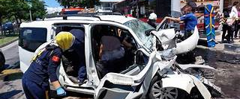
Traffic Accident Analysis Report Overview
An in-depth examination of insights and patterns derived from a comprehensive analysis of 19,000 traffic accident entries, showcasing trends and potential areas for safety improvement.

Slide 2


Group Members
Juan David Barrero Guerrero
Jaturaput Jongsubcharoen
Adorn Shaju
Anand Sharma
Akash Sukumaran

Slide 3

Data Exploration and Modeling Workflow
Data Exploration
Loaded and described data elements.
Statistical assessments (means, averages, correlations).
Missing data evaluations.
Graphs and visualizations.
Data Modeling
Data transformations (missing data, categorical data, normalization).
Feature selection and justification.
Train-test data splitting.
Managing imbalanced classes.
Streamlined pre-processing with pipelines.

Slide 4

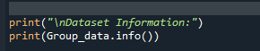
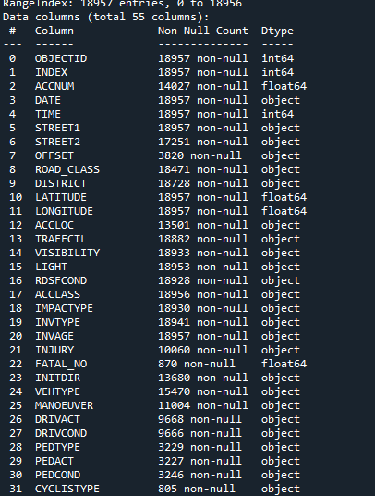
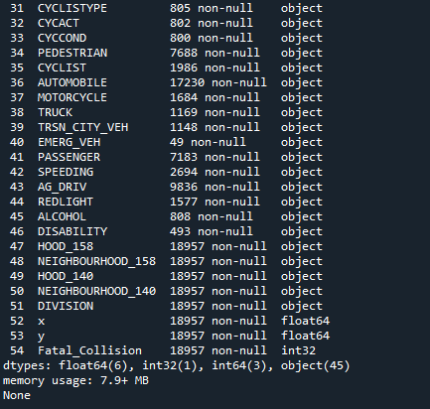
Dataset Overview: Column Information and Data Types

Slide 5

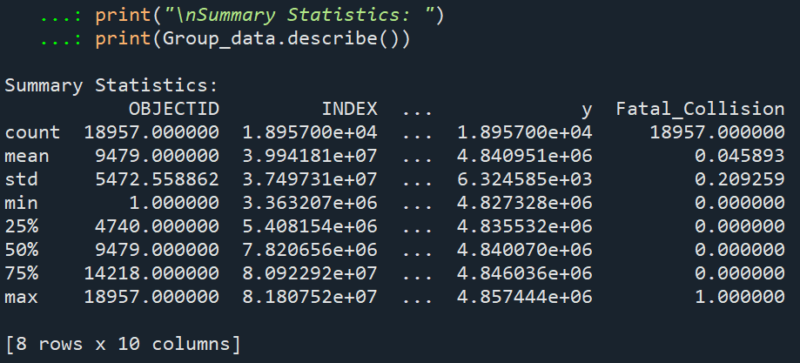
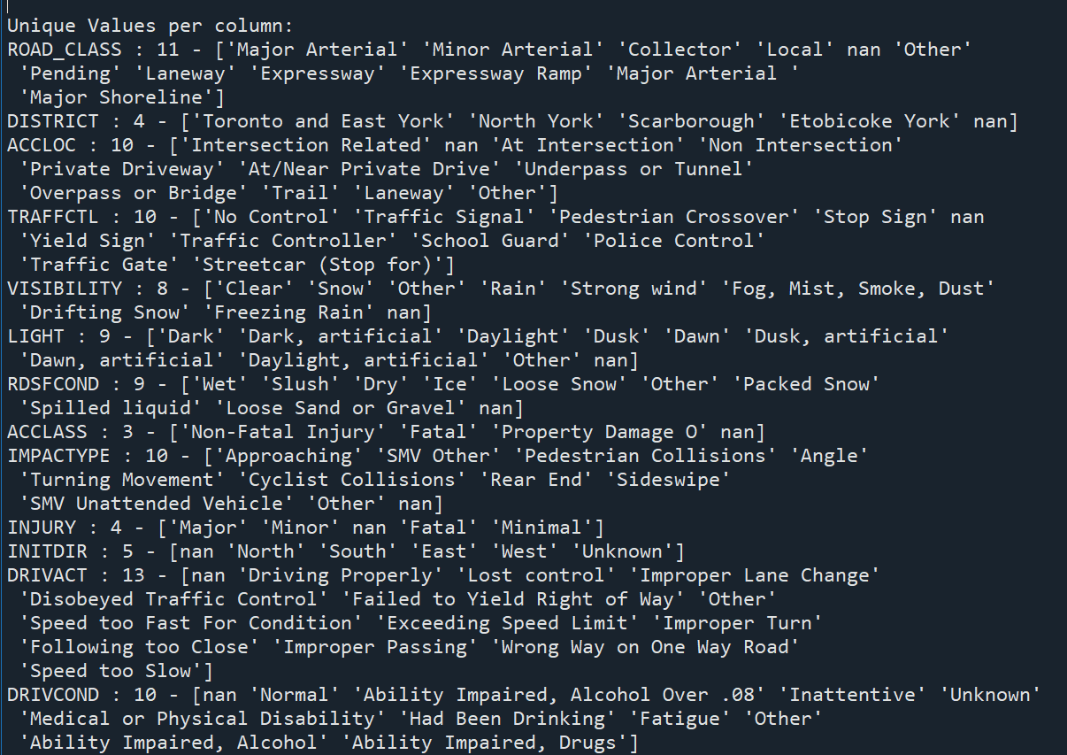
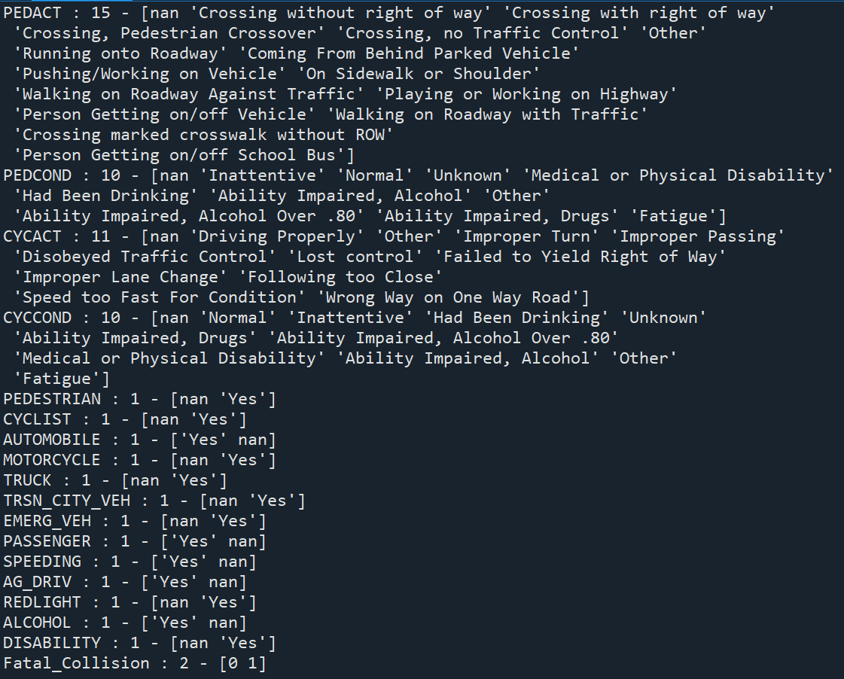
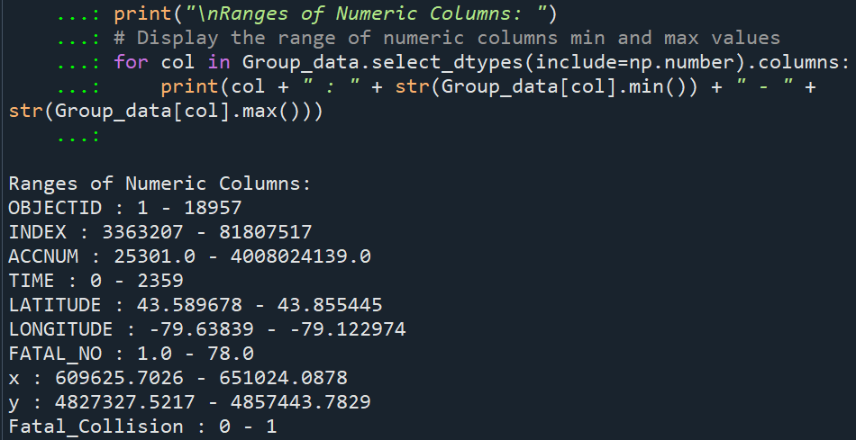
Summary Statistics
Unique Values per column
Ranges of Numeric Columns

Slide 6

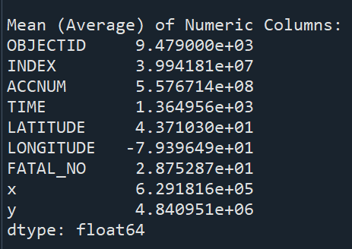
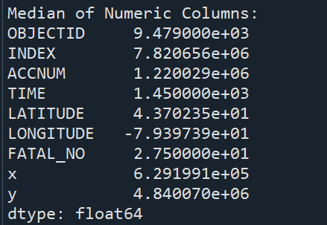
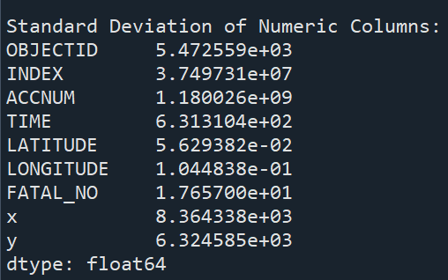
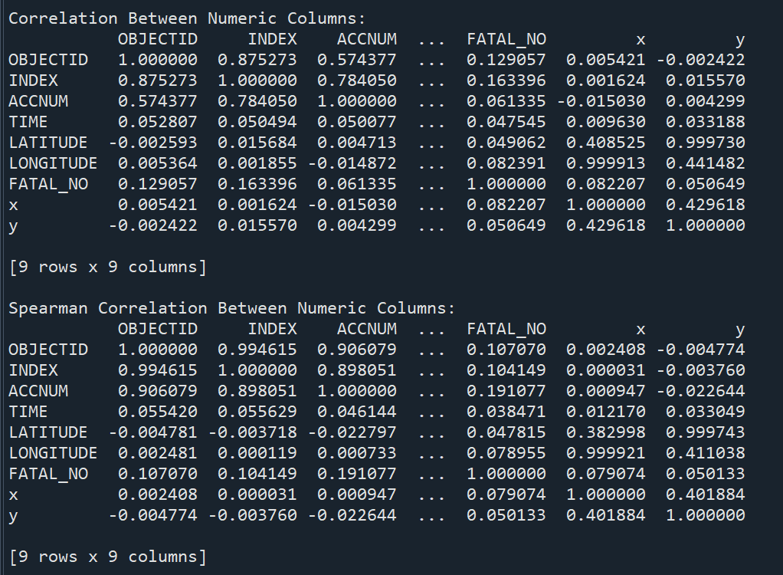
Mean
Median
Standard Deviation
Correlation Between Numberic Column
Spearman Correlation Between Numeric Columns

Slide 7

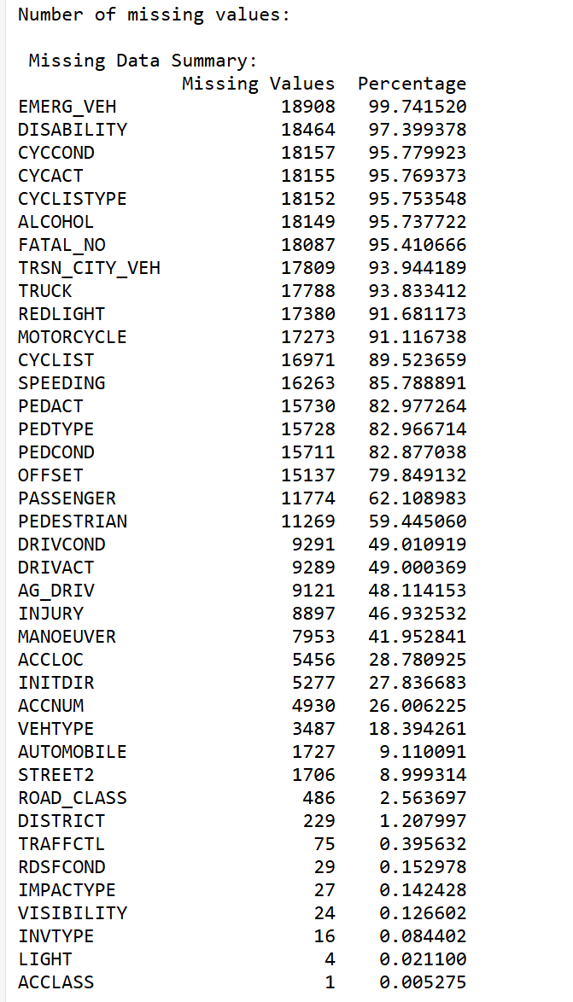
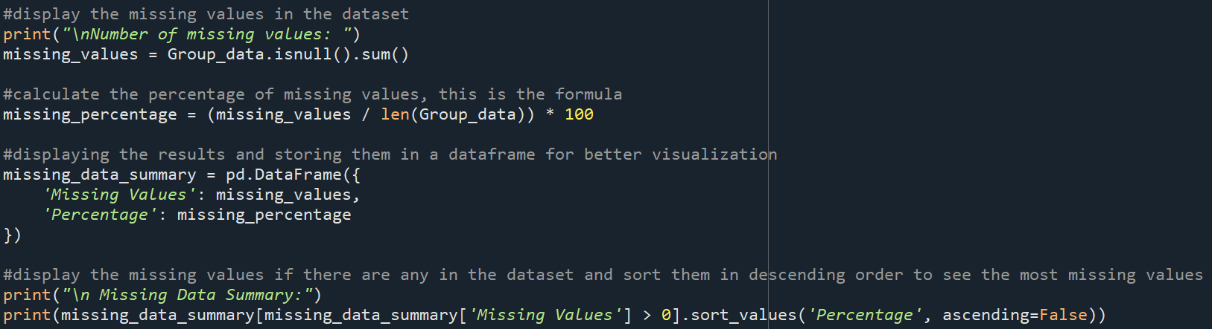
Missing Values

Slide 8

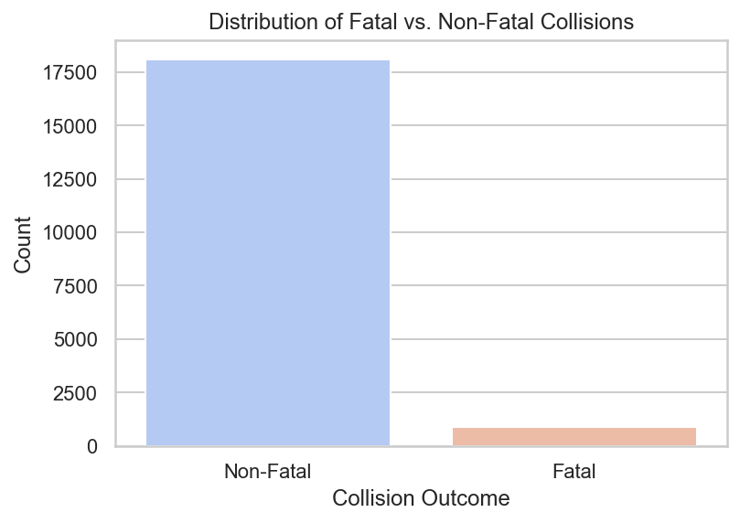
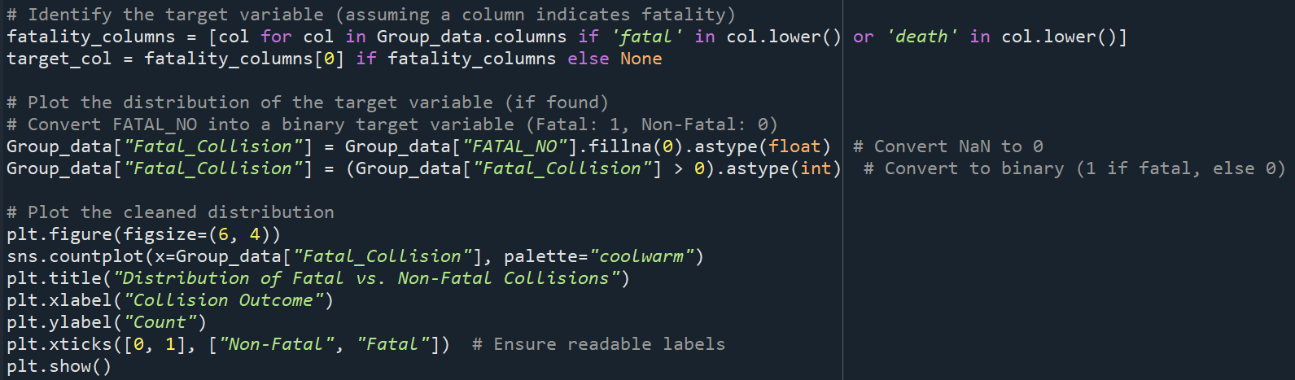
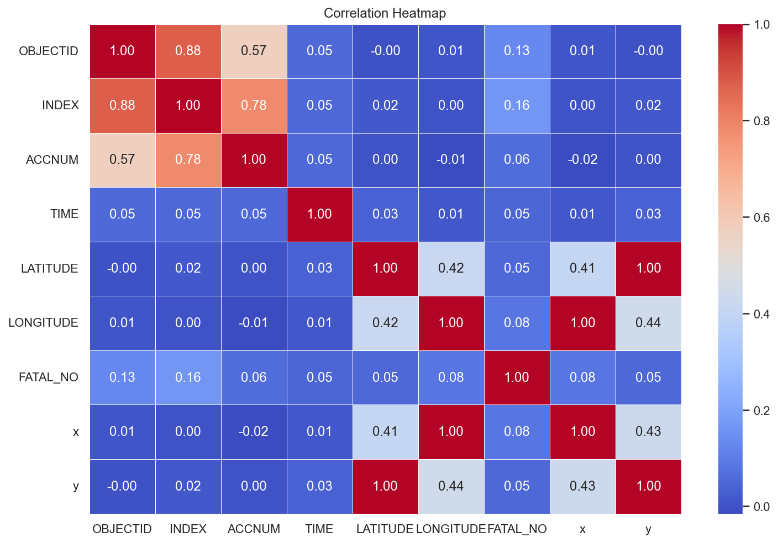
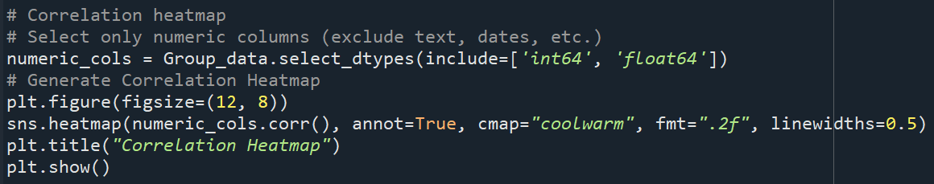
Distribution of Fatal vs. Non-Fatal Collisions
Correlation Heatmap of Numeric Features

Slide 9

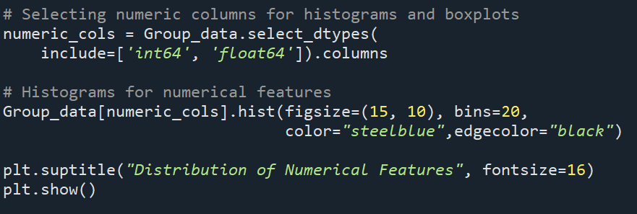
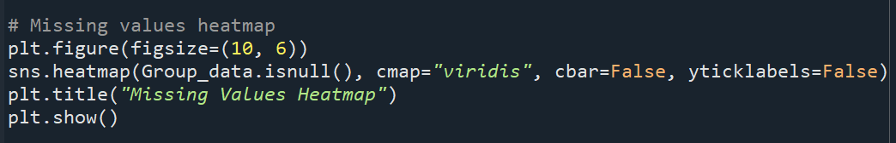
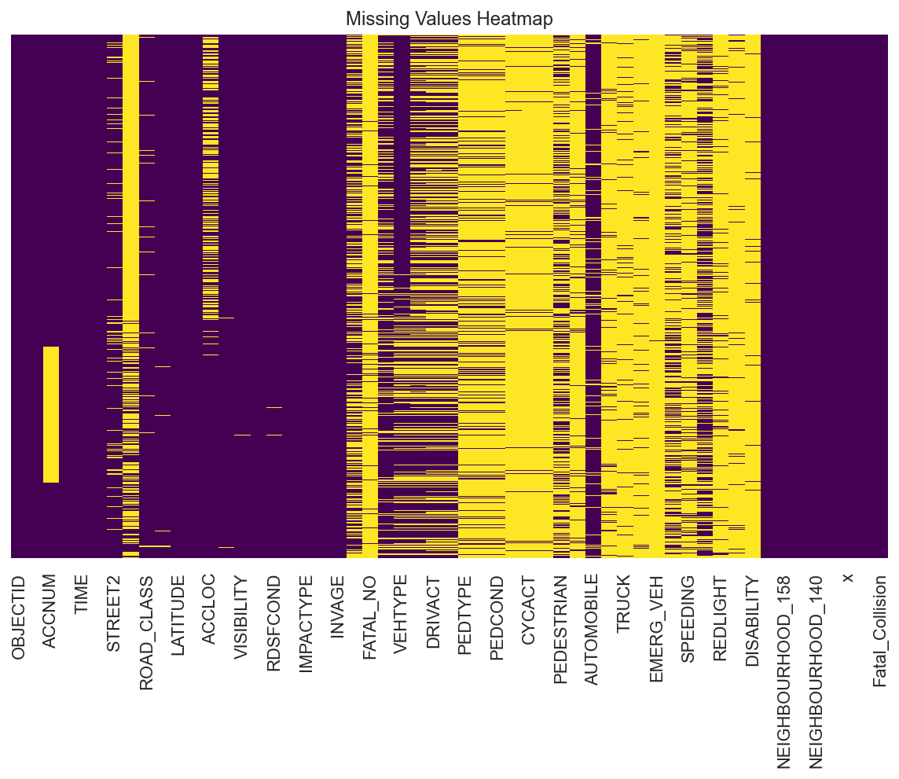
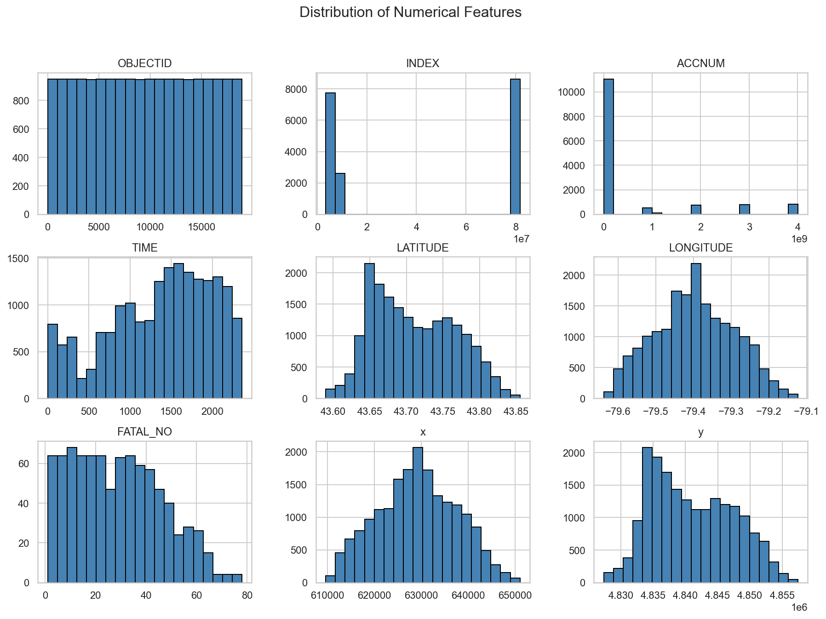
Distribution of Numerical Features
Missing Values Heatmap

Slide 10

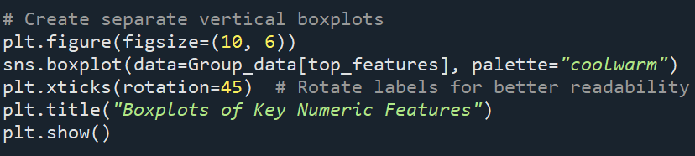
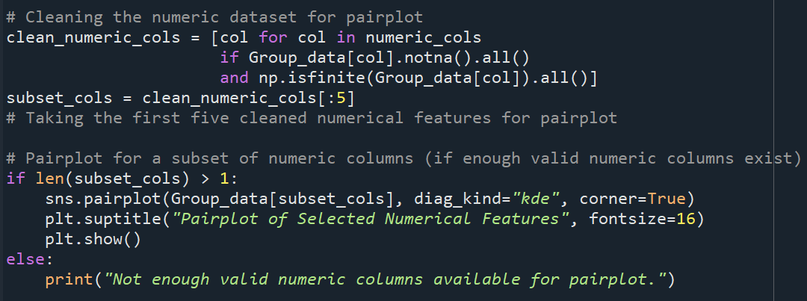
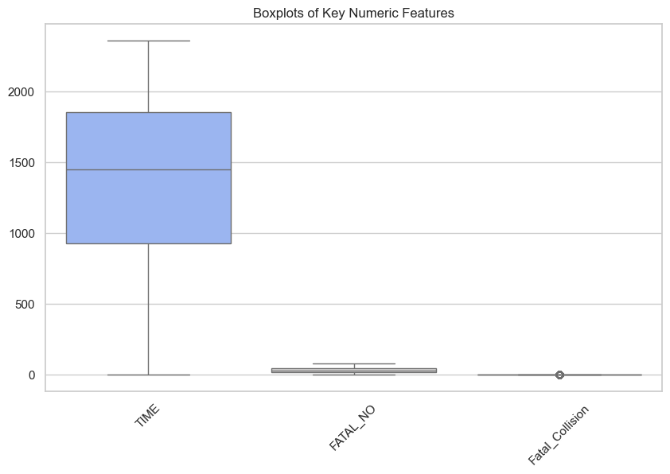
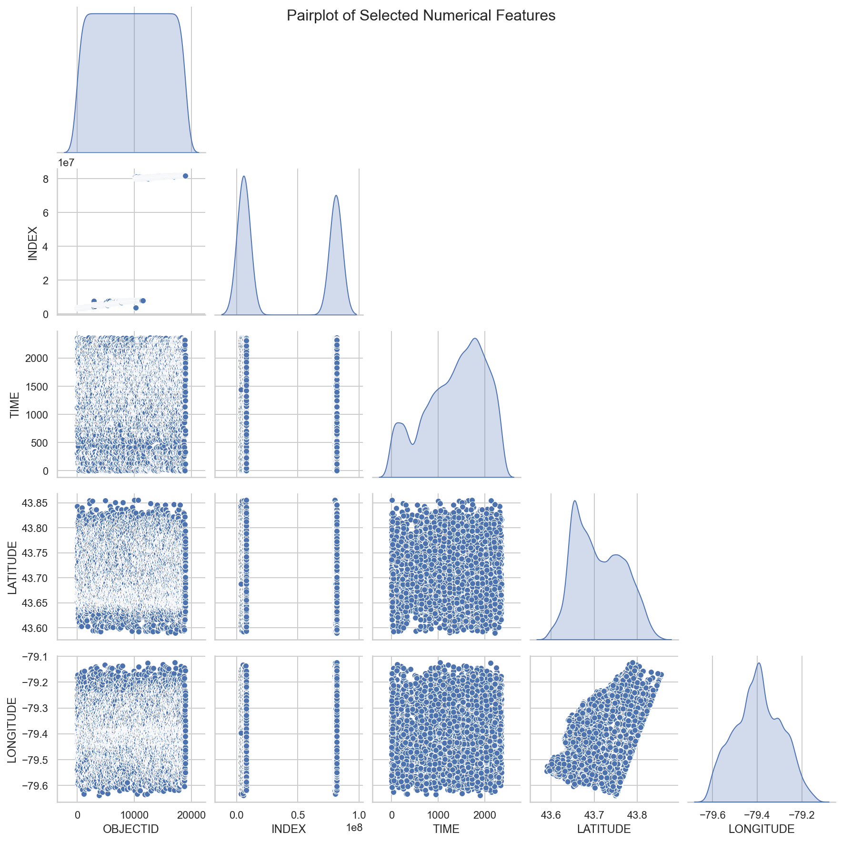
Boxplots of Key Numeric Features
Pairplot of Selected Numerical Features
Purpose: Analyze the spread, central tendency,
and outliers in key numerical variables.
Purpose: Visualize correlations and patterns among key numerical variables

Slide 11

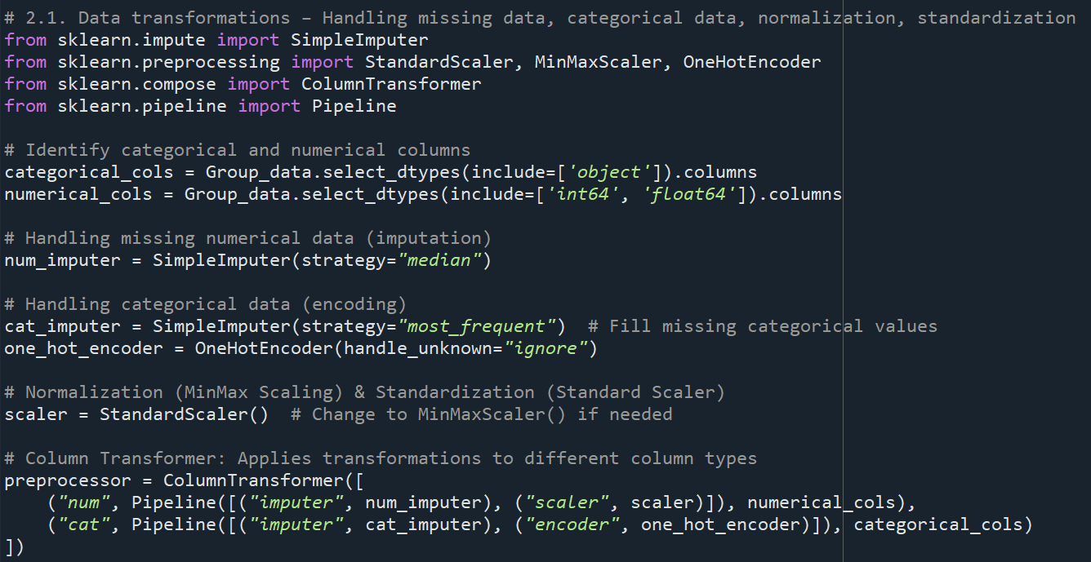
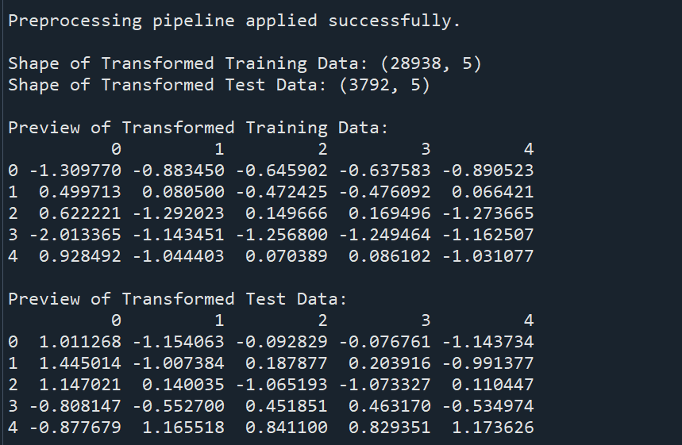
Data Transformations
1. Handling Missing Data
Numerical Columns:
Strategy: Median imputation.
Action: Replace missing values with the median of the column.
Categorical Columns:
Strategy: Most frequent imputation.
Action: Replace missing values with the most frequent category.
2. Encoding Categorical Data
Method: One-Hot Encoding.
Action:
Convert categorical variables into binary (0/1) columns.
Handle unknown categories during encoding.
3. Scaling Numeric Data
Method: Standardization (StandardScaler).
Transform numeric features to have a mean of 0 and a standard deviation of 1.
Alternative: Normalization (MinMaxScaler) can also be used if needed.
4. Preprocessing Pipeline
ColumnTransformer:
Applies different transformations to numeric and categorical columns.
Numeric Pipeline:
Impute missing values → Scale features.
Categorical Pipeline:
Impute missing values → One-hot encode.
Output:
Cleaned, encoded, and scaled dataset ready for modeling.

Slide 12

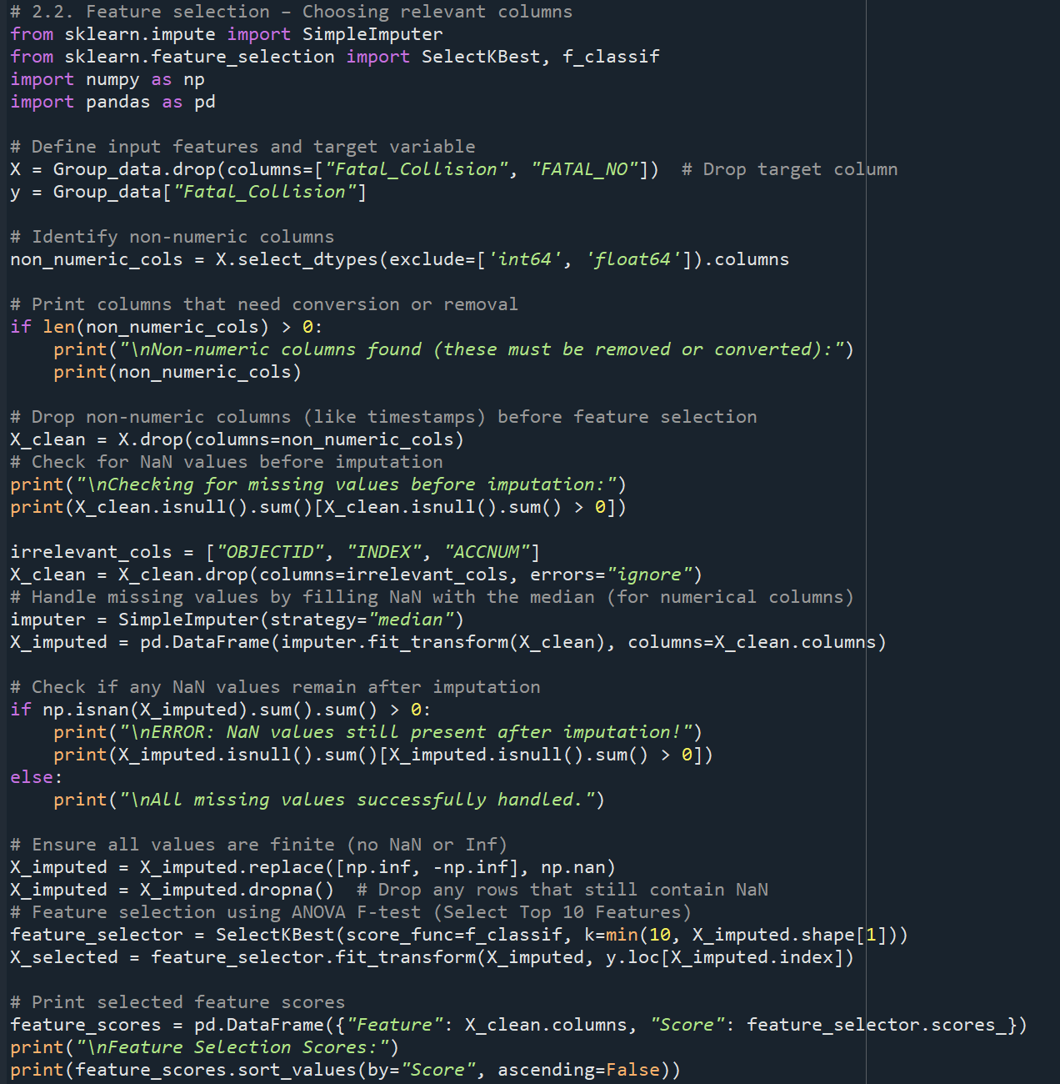
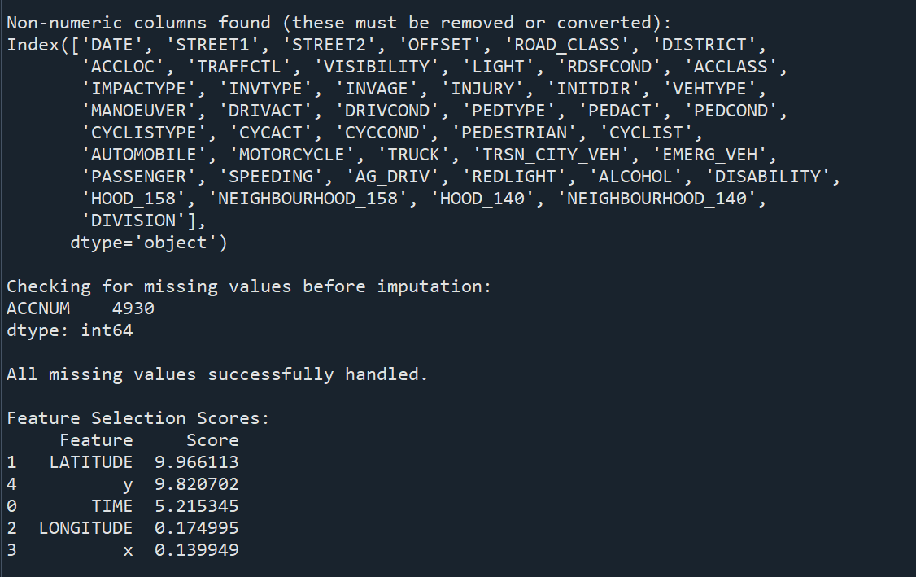
Feature Selection
1, Prepare Data
Drop target column (Fatal_Collision, FATAL_NO).
Remove non-numeric columns.
Drop irrelevant columns (OBJECTID, INDEX, ACCNUM).
2. Handle Missing Values
Impute missing numeric values with median.
Drop rows with NaN or infinite values.
3. Feature Selection
Method: ANOVA F-test.
Action: Select top 10 features based on scores.
Output: Feature importance scores (display top 5-10 features).

Slide 13

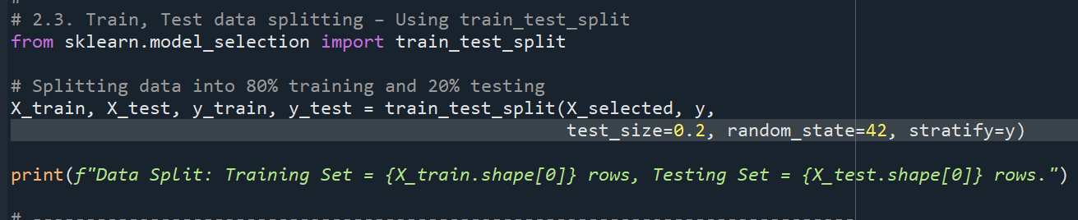
Train-Test Split
Data Split
Training Set: 15,165 rows (80%).
Testing Set: 3,792 rows (20%).
Key Details
Random State: 42 (reproducible results).
Stratify: Ensures balanced class distribution

Slide 14

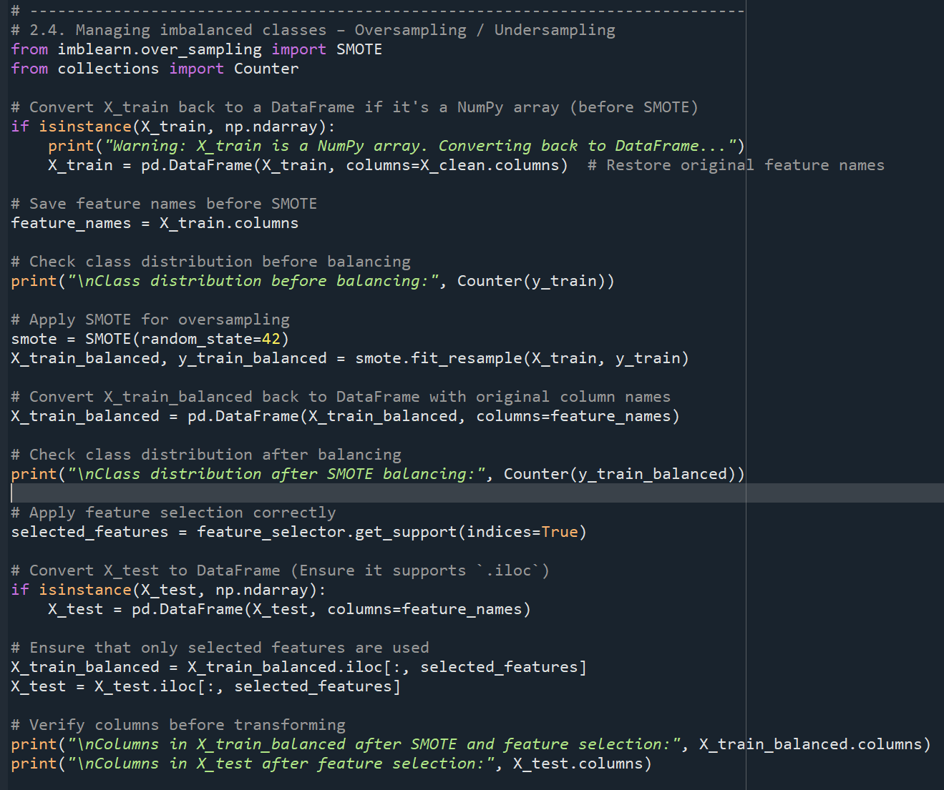
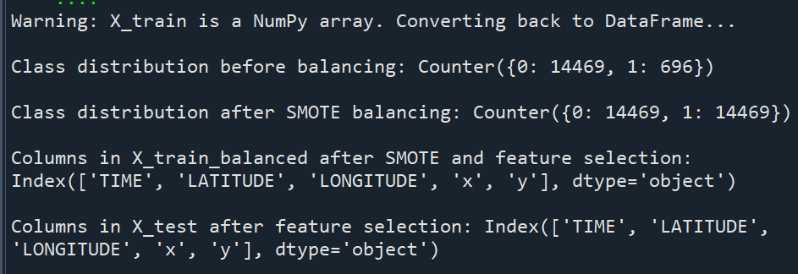
Handling Class Imbalance
Problem
Imbalanced dataset: More non-fatal than fatal collisions
2. Solution
Method: SMOTE (Synthetic Minority Oversampling Technique).
Action: Oversample the minority class (fatal collisions).
3. Class Distribution
Before SMOTE:
Non-Fatal: 14,469.
Fatal: 696.
After SMOTE:
Non-Fatal: 14,469.
Fatal: 14,469.
4. Selected Features
Columns Used:
TIME, LATITUDE, LONGITUDE, x, y.

Slide 15

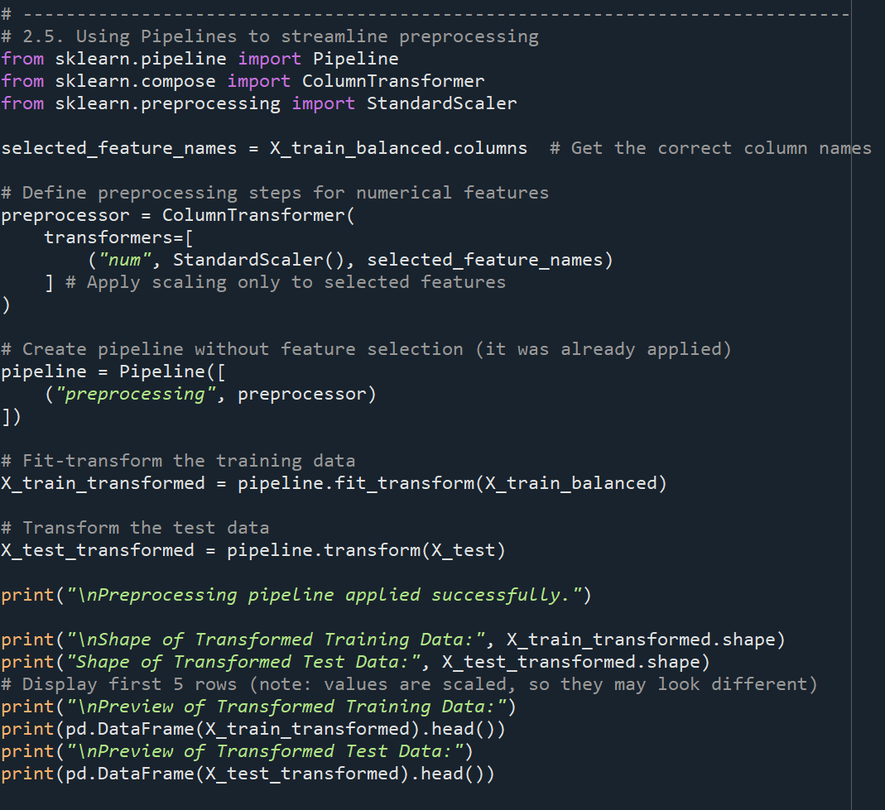
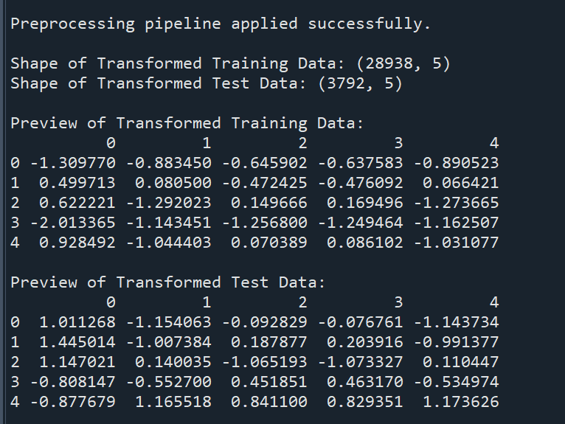
Preprocessing Pipeline
Pipeline Steps
Scaling: Standardize numeric features using StandardScaler.
Features Used:
TIME, LATITUDE, LONGITUDE, x, y
2. Output
Training Data:
Shape: 28,938 rows × 5 columns.
Test Data:
Shape: 3,792 rows × 5 columns.

Slide 16

Conclusion
Key Outcomes
Data Preparation: Eliminated duplicates, managed missing data, and resolved class imbalance using SMOTE.
Feature Selection: Selected the top 10 most relevant features using ANOVA F-test for modeling.
Preprocessing Pipeline: Simplified data transformations (scaling, encoding) to prepare data for modeling.
2. Key Insights
Balanced Dataset: Achieved equal representation of fatal and non-fatal collisions.
Critical Features: Identified significant predictors like TIME, LATITUDE, and LONGITUDE.
Data Readiness: Ensured clean, standardized data for accurate model training.

